Slide 1
Spring AOP
Instruction: NGUYEN ANH MINH (M. Sc.)

Slide 2
Outline
Introduction to Aspect oriented programming
Introduction
Integration with Spring IoC
Program integration using pointcuts

Slide 3
Aspect oriented programming

Slide 4
Aspect oriented programming
Inversion of Control
Aspect-oriented programming
Address broad application responsibilities
Integrating Abstraction
Modularizes responsibility
Logging
Transaction management
Error management
E.g logging
The encapsulation of a responsibility is an advice element

Slide 5
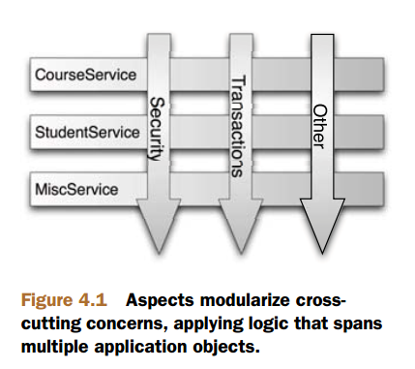
Aspect oriented programming
Identify program facets
Use mechanism beyond traditional OO models
E.g. All POJO getter methods from
Com.company.persistence. Package class members
Target execution point is the joint point
E.g. constructor or method invocation
Program component linking the execution target is point cut
Applies advisor to program facets
An aspect is a single unit association and typing an advice to point cuts

Slide 6
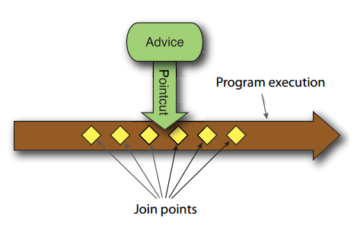
Spring AOP
Programming models
Method –only interceptors
Advisor
Captures advice behavior using plain POJO
AspectJ APIs
Annotation and library APIs
Advice beans are well-formed
Conform to method conventions but not special interfaces
AOP alliance APIs
Advice beans implement interfaces
Spring AOP xml schema advice types

Slide 7
Spring AOP
Point cut
AspectJ API annotations mapped to bean methods
Spring AOP xml schema point cut declarations
Aspect
AspectJ advice with advice and point cut definitions using aspectJ annotations
Spring AOP XML schema aspect declarations

Slide 8
General Spring IoC

Slide 9
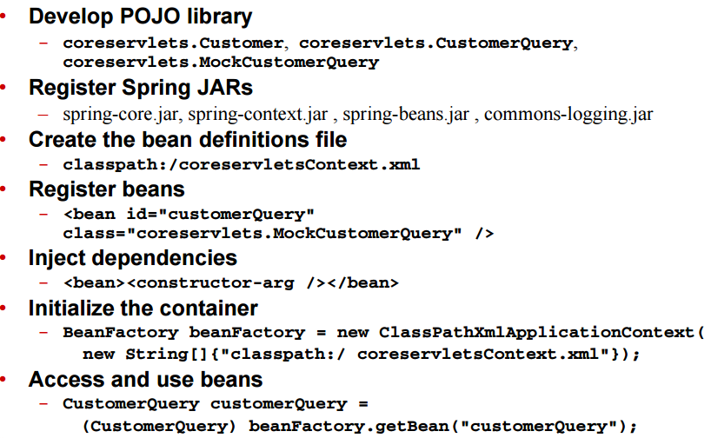
Spring Ioc Process

Slide 10
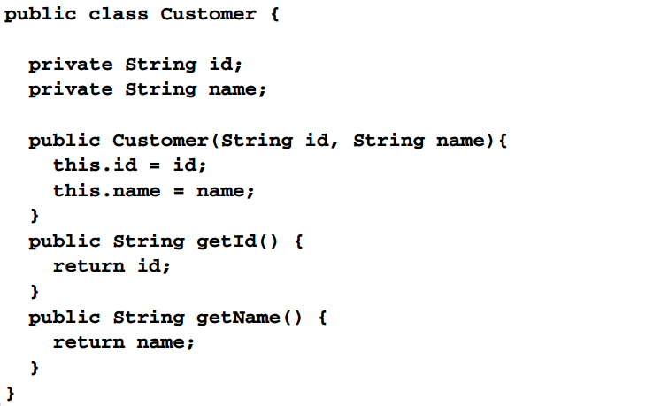
Develop POJO library

Slide 11
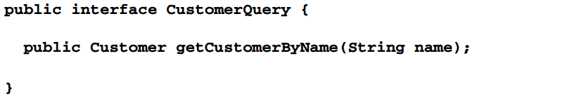
Develop POJO library

Slide 12
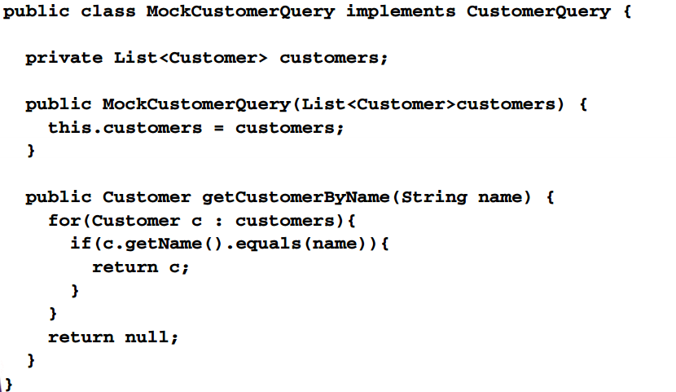
Develop POJO library

Slide 13
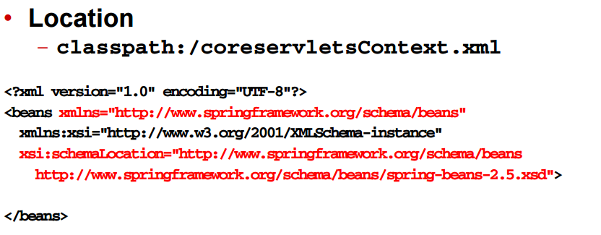
Create bean definitions

Slide 14
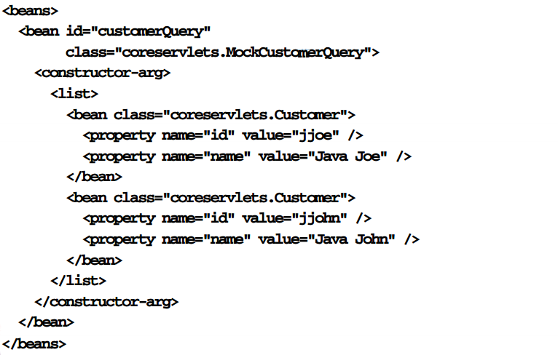
Registering beans and interdependencies

Slide 15
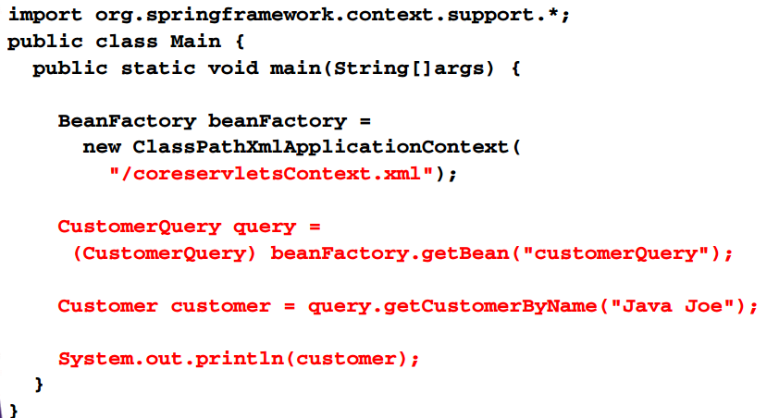
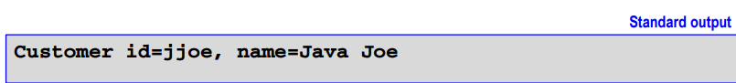
Access and use Beans

Slide 16
Spring AOP helloworld

Slide 17
Spring AOP jars
Spring-aop.jar
Aopalliance.jar
Aspectjweaver.jar
Cglib.jar

Slide 18
Spring AOP helloworld process
Identify concern
Select join pointcuts
All methods exposed by coreservlets.CustomerQuery
Create advice
E.g implement org.aopalliance.intercepts.MethodInterceptor
Create AOP definitions file
Create file classpath://coreservletsAopContext.xml
Register advice beans
<bean/>
Create pointcut definitions
Identify join points
<aop:config><aop:pointcut/></aop:config>
Define aspects
<aop:config><aop:advisor/></aop:config>

Slide 19
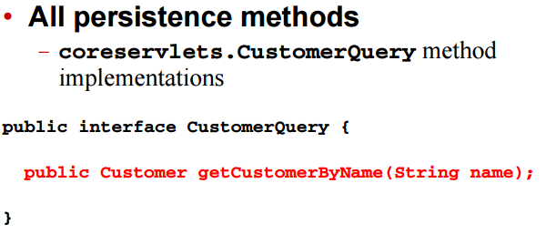
Select join points

Slide 20
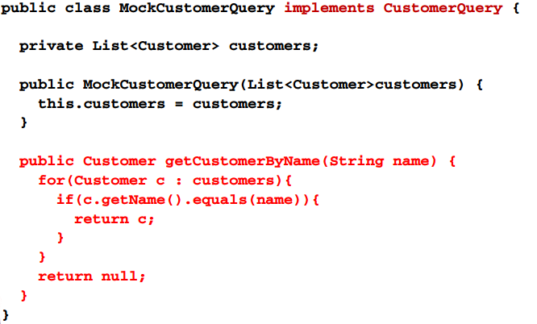
Select join points

Slide 21
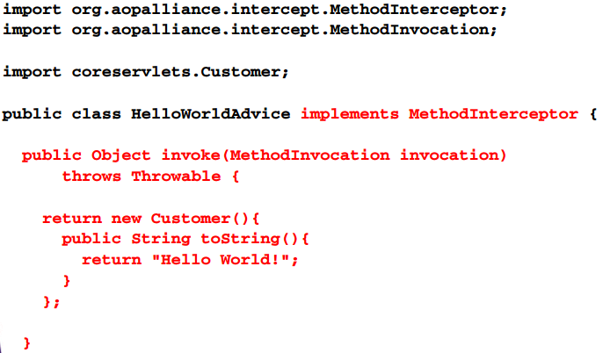
Create advice

Slide 22
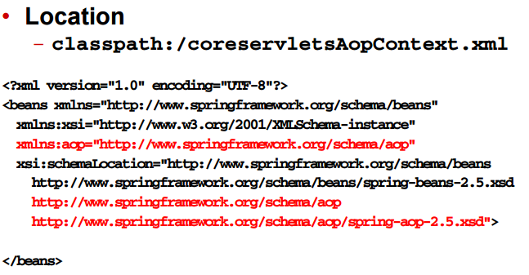
Create AOP definition file

Slide 23
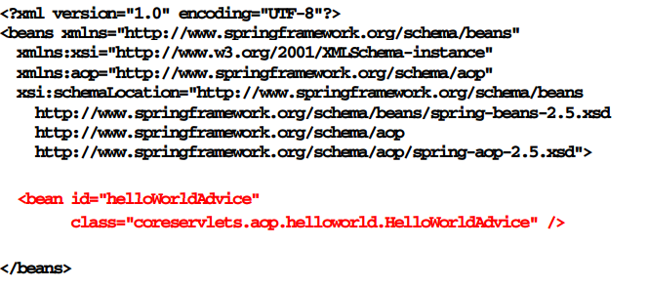
Register advice beans

Slide 24
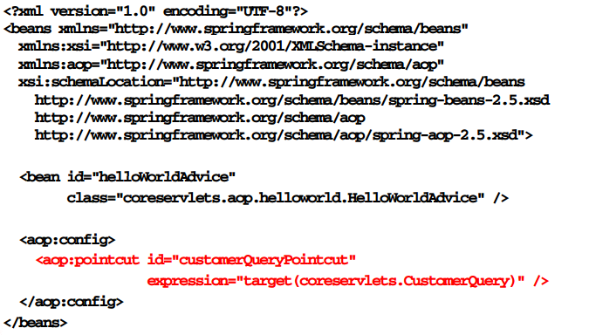
Create pointcut definitions

Slide 25
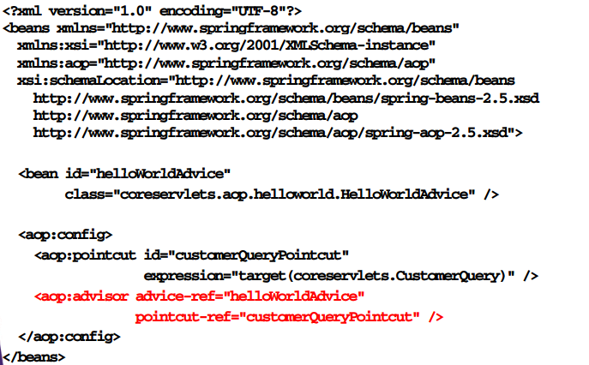
Define aspects

Slide 26
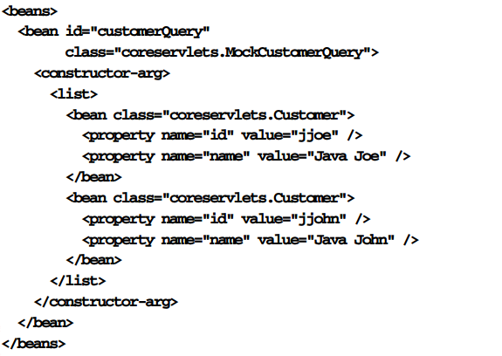
Domain beans

Slide 27
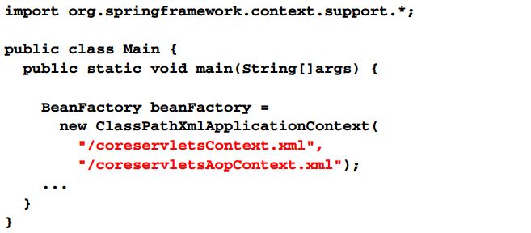
Initialize Spring IoC container

Slide 28
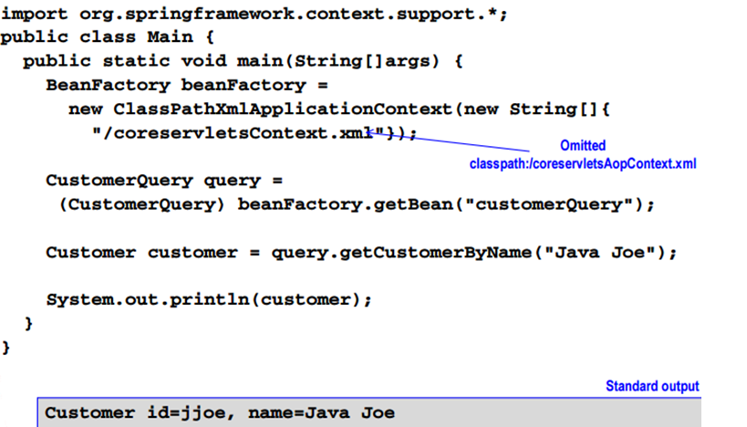
Access and use beans without spring AOP

Slide 29
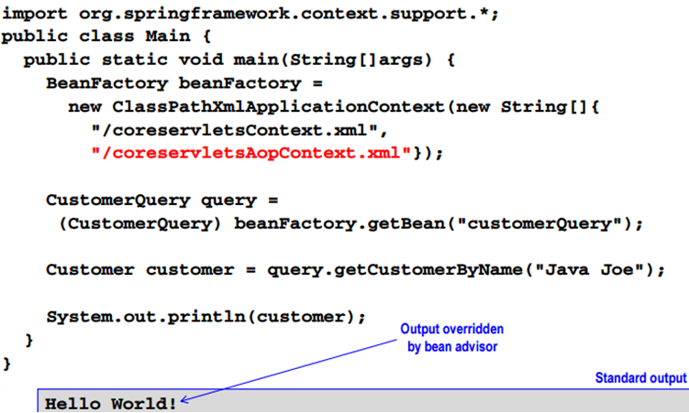
Access and use Beans with spring AOP

Slide 30
Integrated process spring ioc and AOP

Slide 31
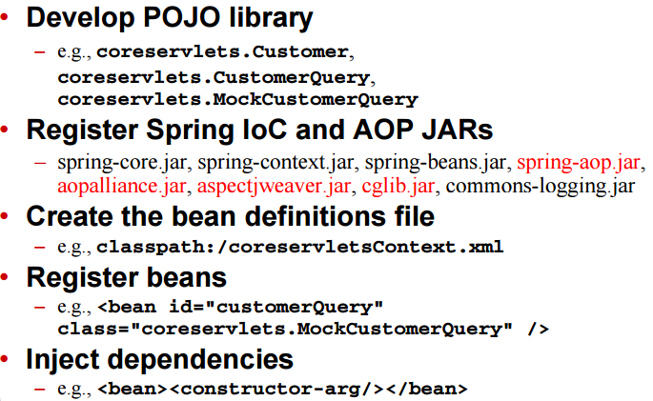
Integrated process spring IoC and AOP, step 1

Slide 32
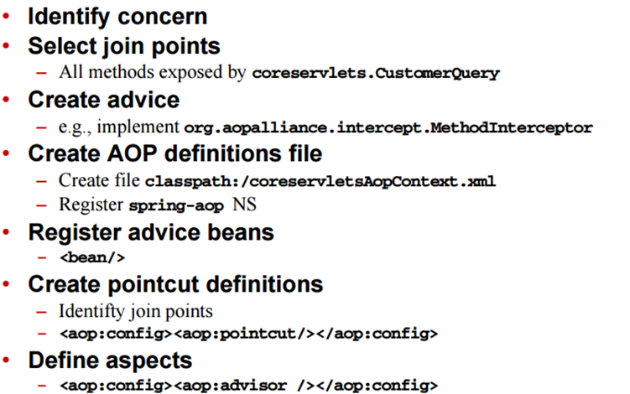
Integrated process spring IoC and AOP, step2

Slide 33
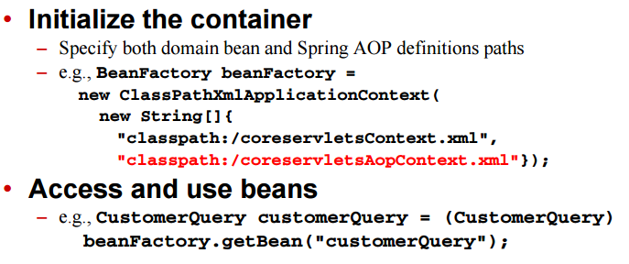
Integrated process spring IoC and AOP , Step3

Slide 34
Addressing the application

Slide 35
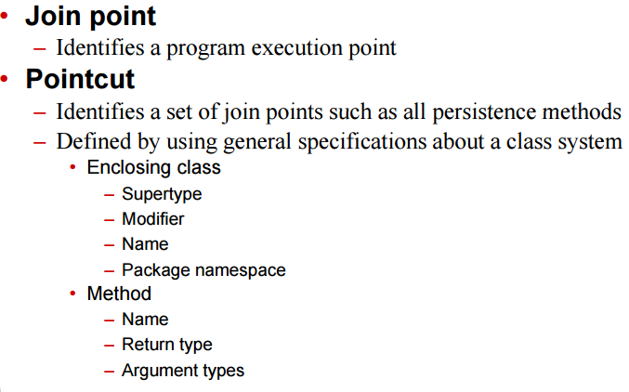
Pointcuts

Slide 36
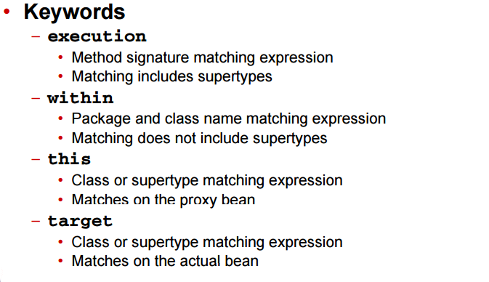
Pointcut definition (PCD)

Slide 37
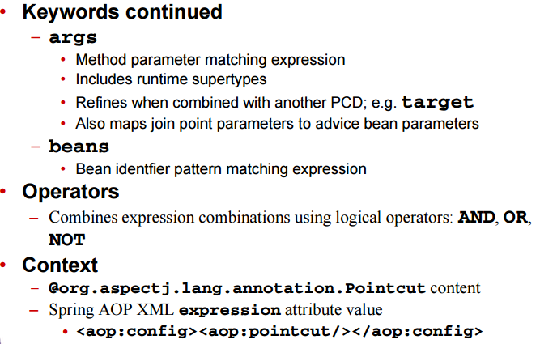
Pointcut definition (PCD)

Slide 38
Execution PCD

Slide 39
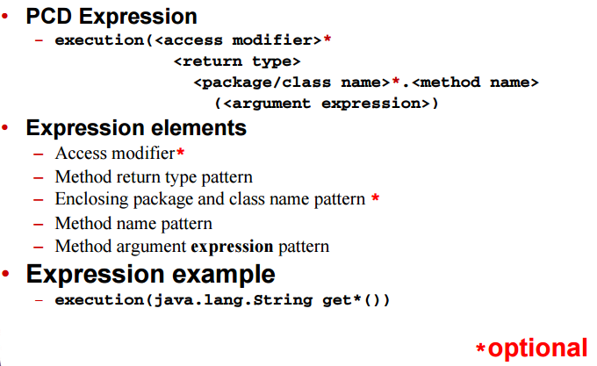
Execution PCD details

Slide 40
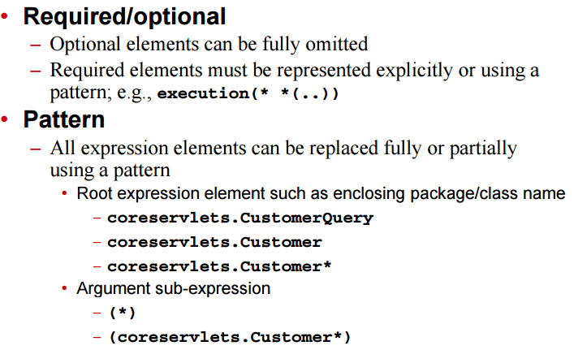
Execution PCD guidelines

Slide 41
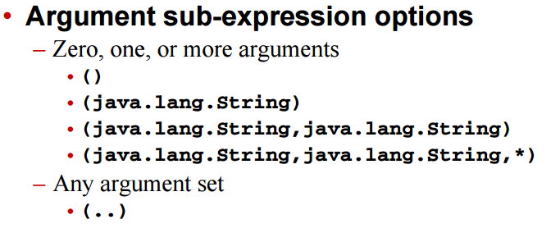
Execution PCD guidelines

Slide 42
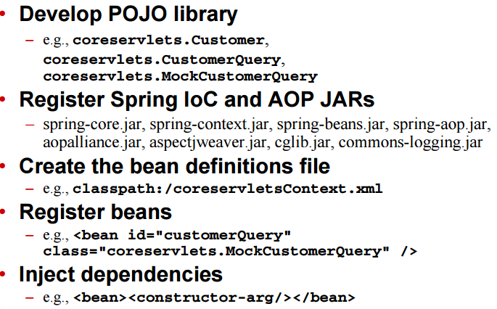
Integrated PCD guidelines, Step1

Slide 43
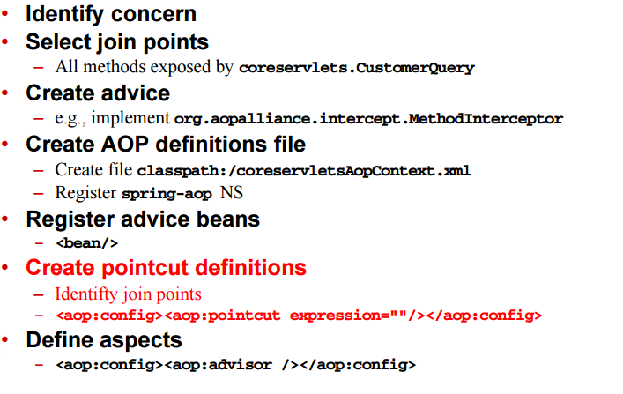
Integrated Process Spring IoC and AOP, Step2

Slide 44
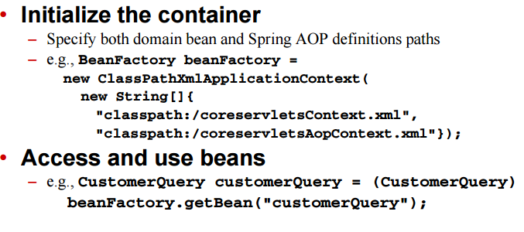
Integrated process spring IoC and AOP ,step3

Slide 45
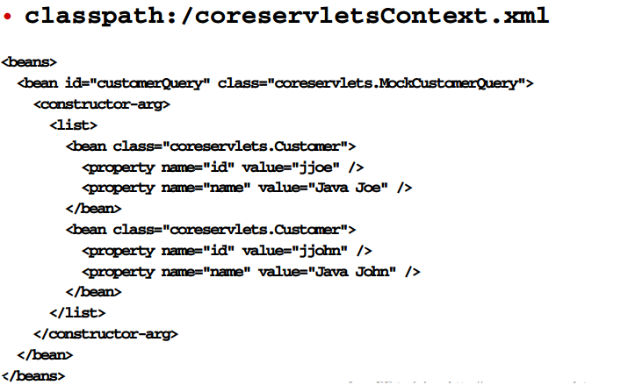
Execution PCD process , Step1 highlights

Slide 46
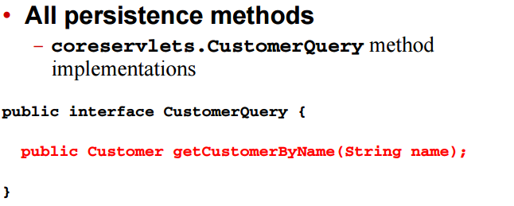
Select join points

Slide 47
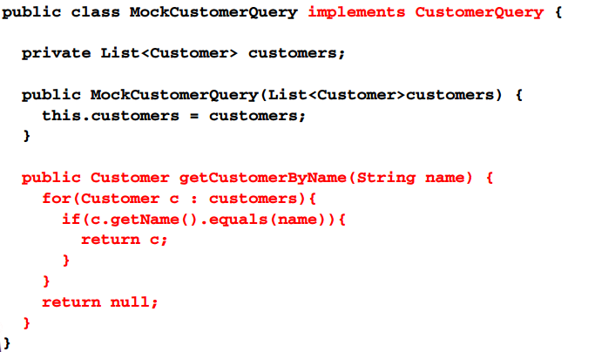
Select join points

Slide 48
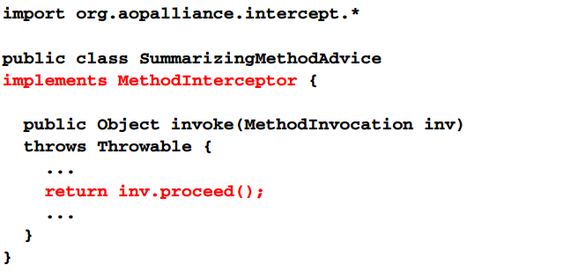
Create advice

Slide 49
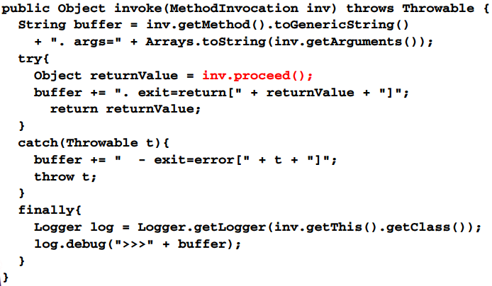
Create advice

Slide 50
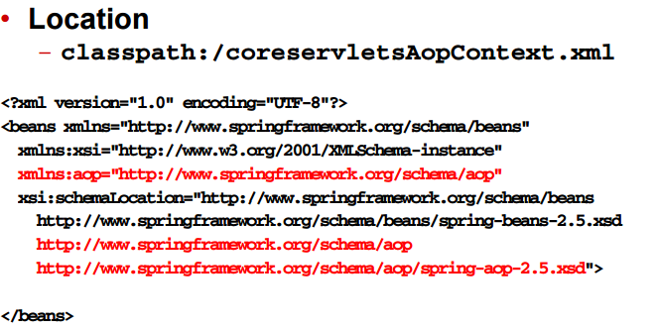
Create AOP definitions

Slide 51
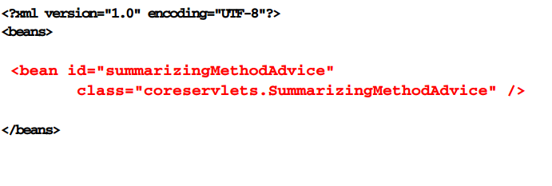
Register advice beans

Slide 52
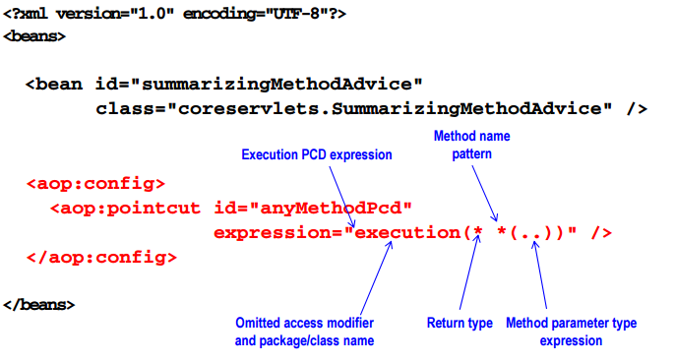
Define pointcuts

Slide 53
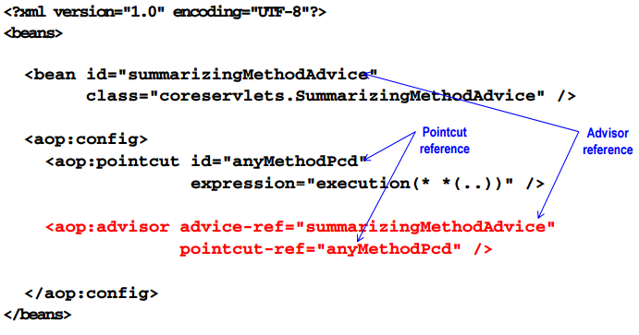
Define aspects

Slide 54
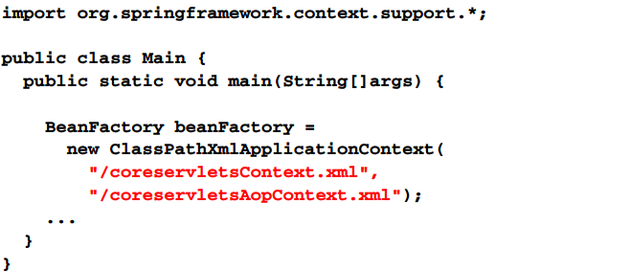
Initialize spring IoC container

Slide 55
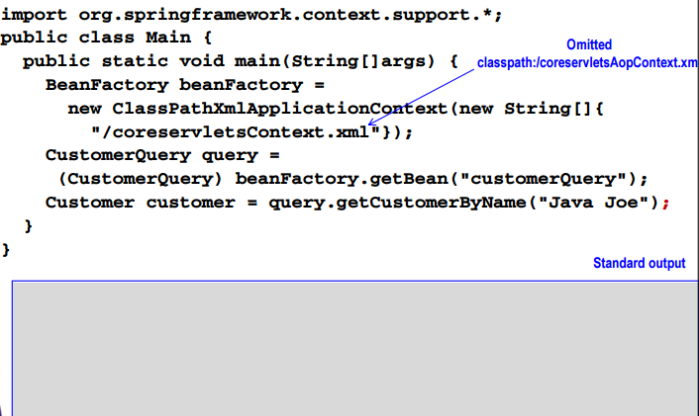
Access and use beans without spring AOP

Slide 56
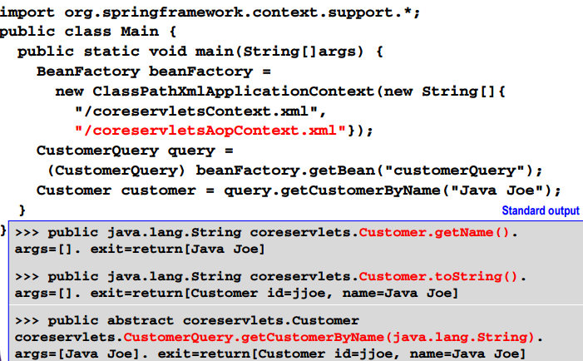
Access and use beans with spring AOP

Slide 57
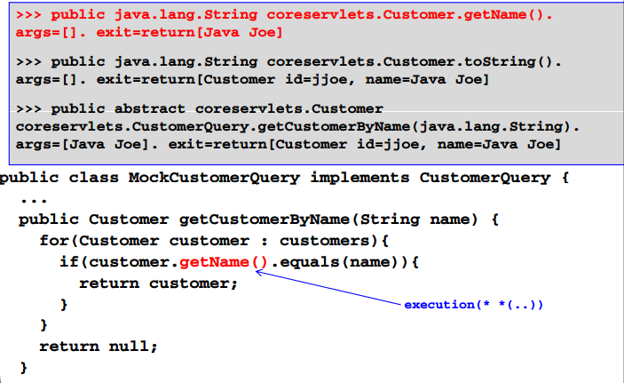
Execution PCD match origins

Slide 58
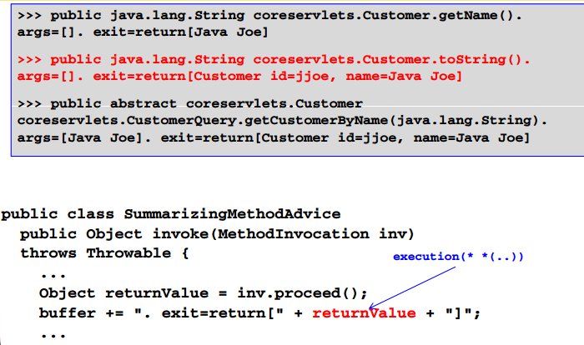
Execution PCD match origins

Slide 59
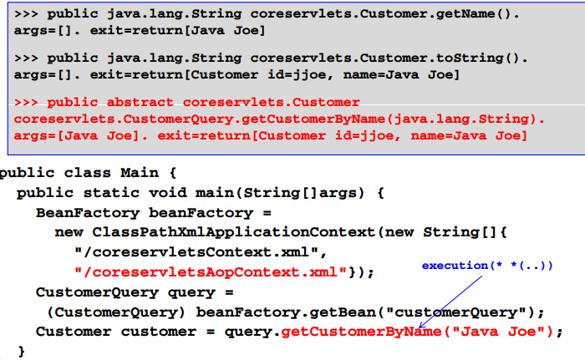
Execution PCD match origins

Slide 60
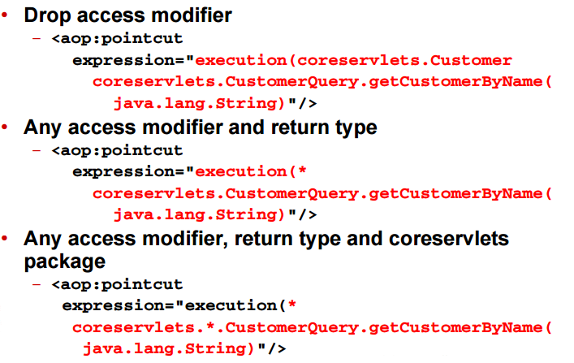
More execution PCD examples

Slide 61
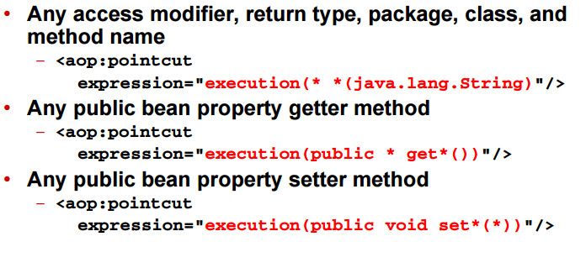
More execution PCD examples

Slide 62
Within PCD

Slide 63

Within PCD details

Slide 64

Within PCD guidelines

Slide 65

Integrated process spring IoC and AOP

Slide 66

Integrated process spring IoC and AOP, Step2

Slide 67

Integrated process spring IoC and AOP , Step3

Slide 68

Execution PCD process step1 hightlights

Slide 69

Select join points

Slide 70

Create advice

Slide 71

Create advice

Slide 72

Create AOP definitions

Slide 73

Register advice beans

Slide 74

Define pointcuts

Slide 75

Define aspects

Slide 76

Inititalize spring Ioc container

Slide 77

Access and use beans without spring AOP

Slide 78

Access and use beans with spring AOP

Slide 79

Execution PCD match origins

Slide 80

Execution PCD match origins

Slide 81

Execution PCD match origins

Slide 82

More execution PCD examples

Slide 83

More execution PCD examples

Slide 84
Within PCD

Slide 85

Within PCD details

Slide 86

Within PCD guidelines

Slide 87

Integrated process spring IoC and AOP, step1

Slide 88

Integrated process spring IoC and AOP , step2

Slide 89

Integrated process spring IoC and AOP, step3

Slide 90

Execution PCD process Spring IoC and AOP,step3

